Slide 1
Improving Application Lifecycle Management

Slide 2
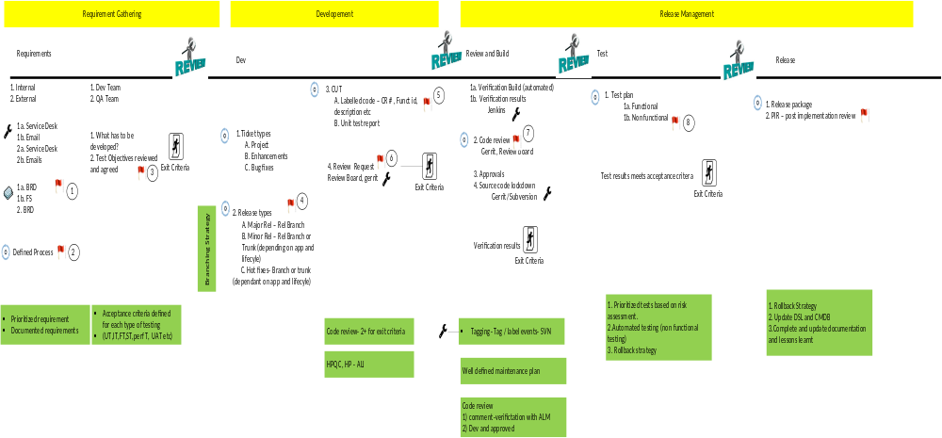
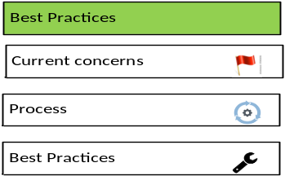
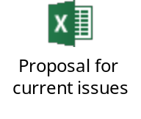
Project Lifecycle
| Maximintegrated | Confidential

Slide 3
Current Major Challenges
Release Strategy
Code Review and Build integration
Coding standard
Test
| Maximintegrated | Confidential

Slide 4
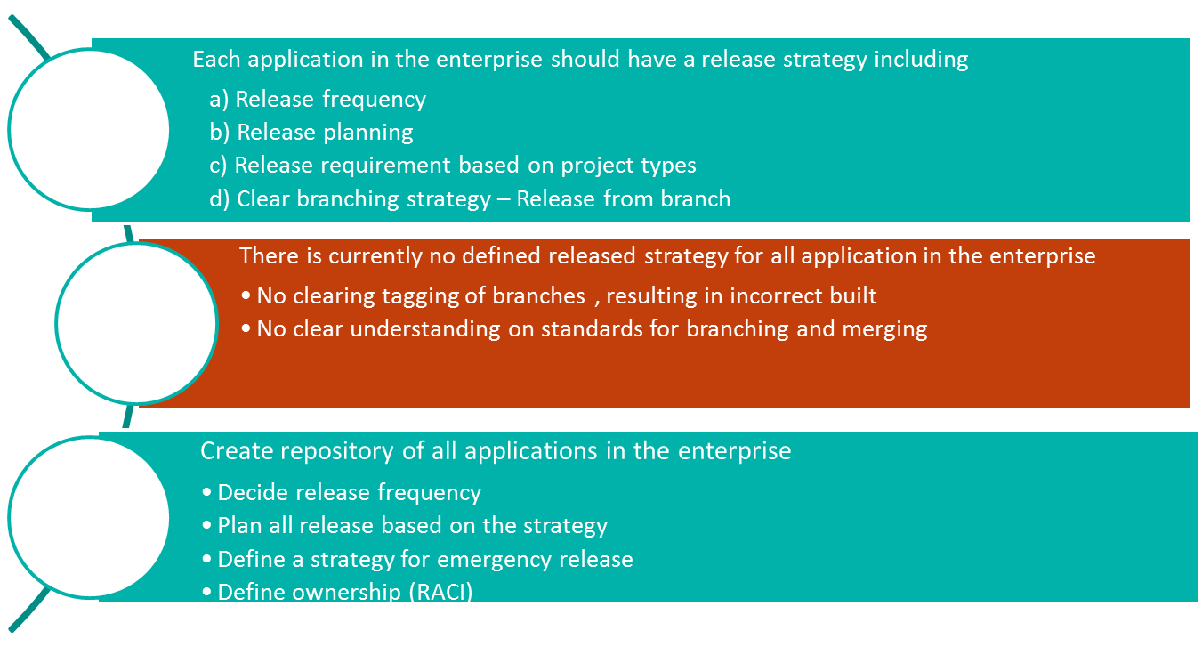



Release Strategy
| Maximintegrated | Confidential

Slide 5
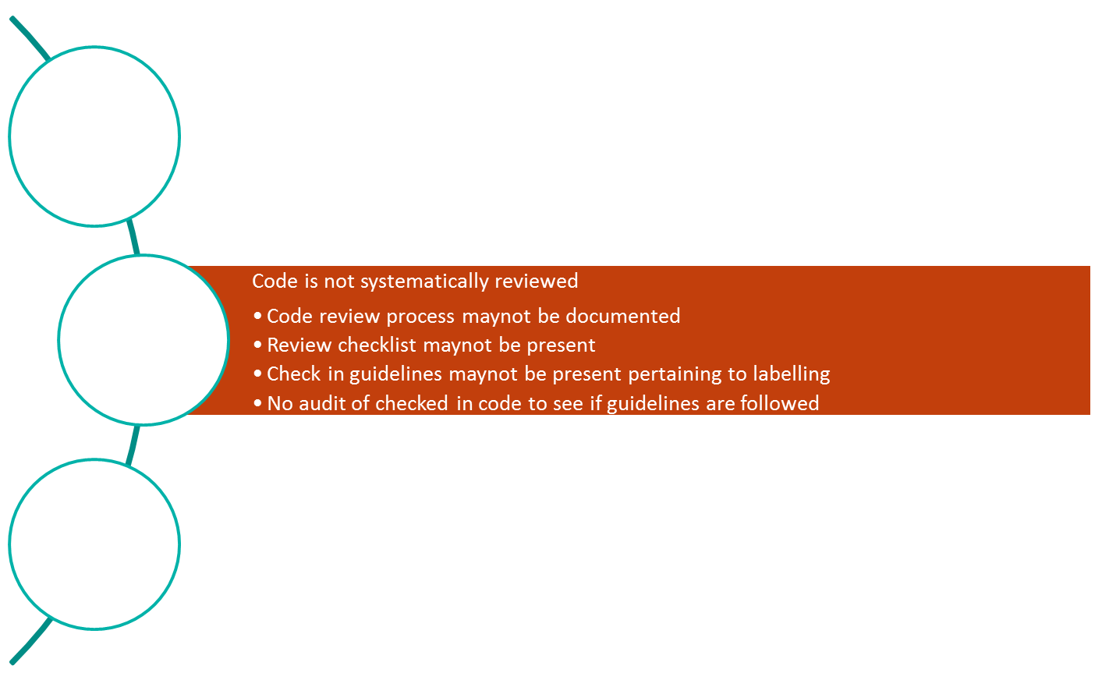


Code Review and Build
All code is reviewed by peer. Only fully verified build and approved code is picked by test for testing Code review is done on the basis of a checklist Automatic enforcement of some standards with code analytics tool | Reviewer doesnot start review if labelling is not followed. Reviewer starts review only when Verification build is complete. Code review is done using automate tools like Gerrit, Crucible, Review Board etc.
Define code review guidelines and process Manual (not mistake proofed) Developer inform reviewer to do a peer review Reviewer reviews code and approves Developer and reviewer check-in code with comments ,approval , CR# and description (minimum reqs) Random audit of checked in code and report metrics | Automated Use tools like Gerrit Only approved code can be submitted Integrate HP-ALI to check status of tested vs untested code (ALI is an extension available for HPQC)
| Maximintegrated | Confidential

Slide 6
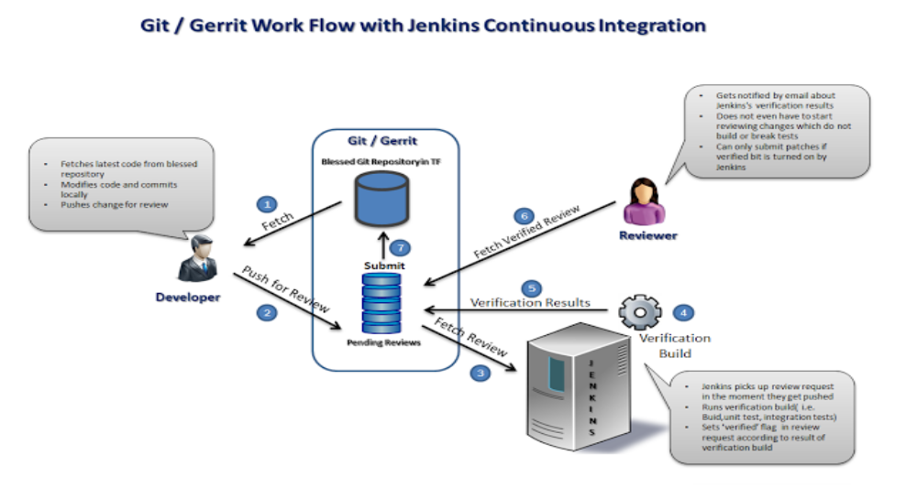
Automated code review and CI
| Maximintegrated | Confidential

Slide 7
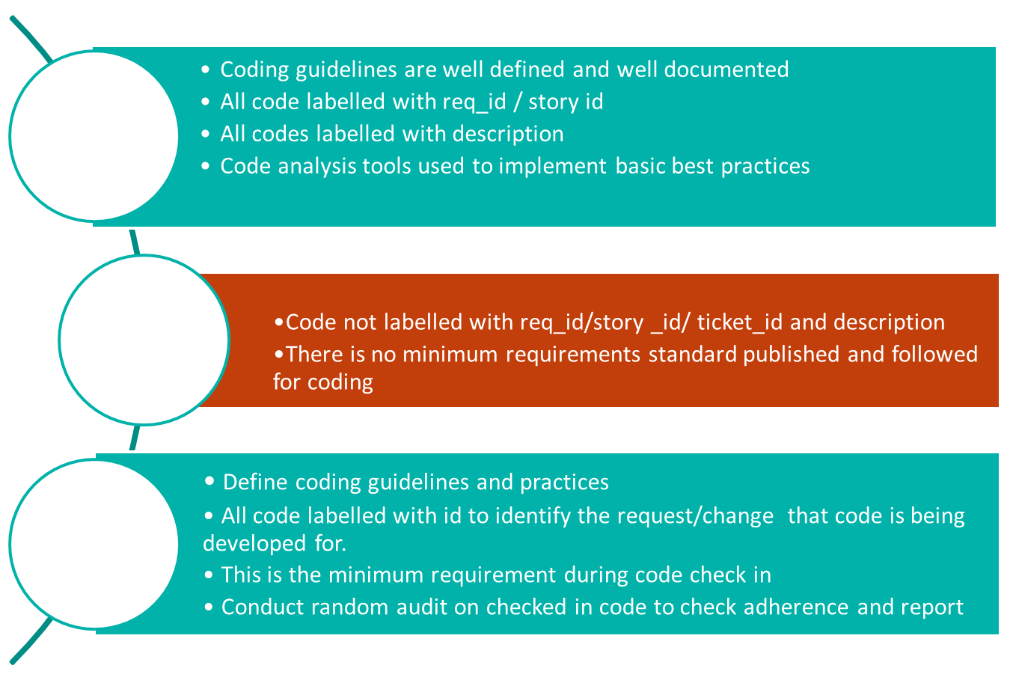

Coding standard
| Maximintegrated | Confidential

Slide 8
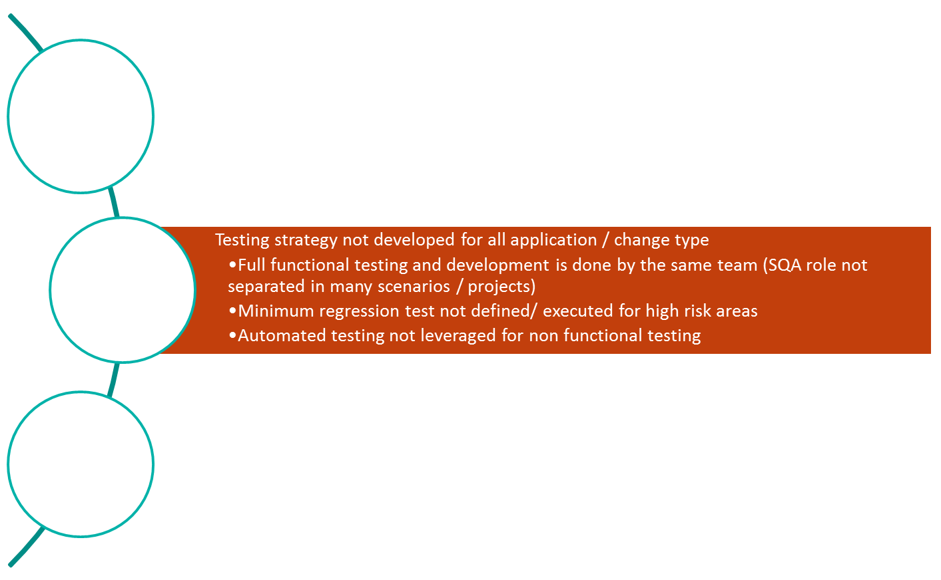
Test
Defined testing strategy for all enterprise application Test scenarios and strategy developed based on risk assessment Each application has minimum acceptance criteria defined for test scenarios Regression done for all critical features (p0) Automated testing utilized for non functional testing
Create repository for all application Define testing strategy (what will and will not be covered) based on risk assessment Pick only validated and approved build Use the same build for CAB approval post testing Define acceptance criteria for all changes at the beginning with the stake holders
| Maximintegrated | Confidential

Slide 9
Prioritization
Code review process and tool (Gerrit / other opensource tool and Jenkins integration )
Code review guidelines and checklist
Deployment checklist
HP –ALI integration Update DSL or CMDB with all applications in the enterprise
Define structure in HPQC (any other) for all applications with release cycles and impacted CI
Define min req for check-in (reqid/CR#)
For all Application
Release strategy
Branching strategy
Test and build strategy
Coding standards
Communication strategy
Change management strategy
Audits and metrics deployments (dev and test)
Requirement gathering process, tools and templates
Automation for non functional testing
Operational review process
RACI for all processes
  Rel Management
  Req Gathering
  Testing
  Build
  Deployment
| Maximintegrated | Confidential

